Slide 1
Micro-hydro
PowerPoint presentation
Unit 301: Understand the fundamental principles and requirements of environmental technology systems

Slide 2
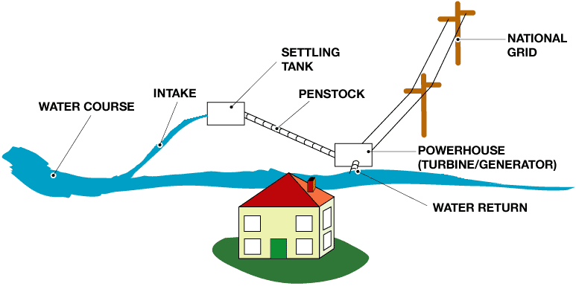
Micro-hydro
Small-scale hydropower is one of the most cost-effective and reliable energy technologies to be considered for providing clean electricity generation.
Running water can be used to generate electricity, whether it's a small stream or a larger river.

Slide 3
Micro-hydro
Small or micro hydroelectricity systems, also called hydropower systems or just hydro systems, can produce enough electricity for lighting and electrical appliances in an average home.

Slide 4
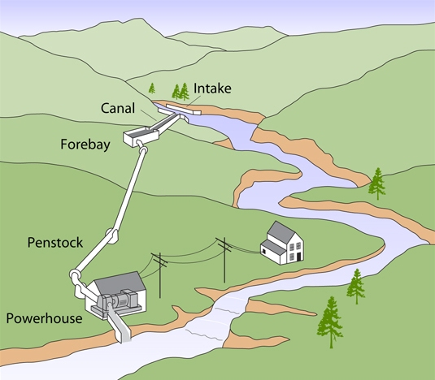
Micro-hydro
Water is taken from the river by diverting it through an intake at a weir.
In medium or high-head installations water may first be carried horizontally to the forebay tank by a small canal or ‘leat’.
Before descending to the turbine, the water passes through a settling tank or ‘forebay’ in which the water is slowed down sufficiently for suspended particles to settle out.

Slide 5
Micro-hydro
The forebay is usually protected by a rack of metal bars (a trash rack) which filters out water-borne debris.
A pressure pipe, or ‘penstock’, conveys the water from the forebay to the turbine, which is enclosed in the powerhouse together with the generator and control equipment.
After leaving the turbine, the water discharges down a ‘tailrace’ canal back into the river.

Slide 6
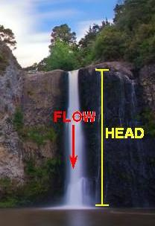
Micro-hydro
Flow – how much water is flowing down the water course per second.
Head – available vertical fall in the water, from the upstream level to the downstream level.

Slide 7
Micro-hydro
The general formula for micro‑hydro system’s power output is:
P | = | η g Q H
Where: | P | = | mechanical power produced at the turbine shaft (Watts)
 | η | = | hydraulic efficiency of the turbine, (expressed as a decimal)
 | g | = | acceleration due to gravity (9.81m/s²)
 | Q | = | flow rate passing through the turbine (litres/second)
 | H | = | head of water across the turbine (m)

Slide 8
Micro-hydro
Example 1 – A micro‑hydro system has a flow rate of 20 litres/second passing through the turbine fed from an effective head of 10 metres. The effective hydraulic efficiency of the turbine is 60%. Calculate the mechanical power produced at the turbine shaft.
P | = | Η g Q H
 | = | 0.6 x 9.81 x 20 x 10
 | = | 1177W

Slide 9
Micro-hydro
Example 2 – If the electrical generator in example 1 has an efficiency of 70%, the electrical power generated would be:
P | = | Efficiency x Input power
 |  | 100
 | = | 70 x 1177
 |  | 100
 | = | 824W

Slide 10
Planning permission and Building Regulations
Planning permission required.
Environmental Agency will need consulting.
Abstraction Licence also required from Environmental Agency.
Building Regulations required for buildings constructed.

Slide 11
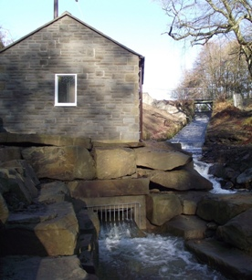
Advantages of micro-hydro
Efficient energy source – a hydro system can generate 24 hours a day, often generating all the electricity the consumer needs and more.
Reliable electricity source; hydro produces a continuous supply of electrical energy in comparison to other small-scale renewable technologies.
If eligible, the consumer will get payments from the feed in tariff for all the electricity generated, as well as for any surplus electricity sold back to the grid.
Hydroelectricity is green, renewable energy and doesn't release any harmful carbon dioxide or other pollutants.
No reservoir for ‘run of river’ installations required.

Slide 12
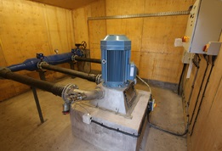
Disadvantages of micro-hydro
Large initial capital outlay.
Suitable site characteristics required.
Energy expansion not possible; the size and flow of small streams may restrict future site expansion as the power demand increases.
Low-power in the summer months.
Environmental impact.

Slide 13
Any questions?

